Slide 4
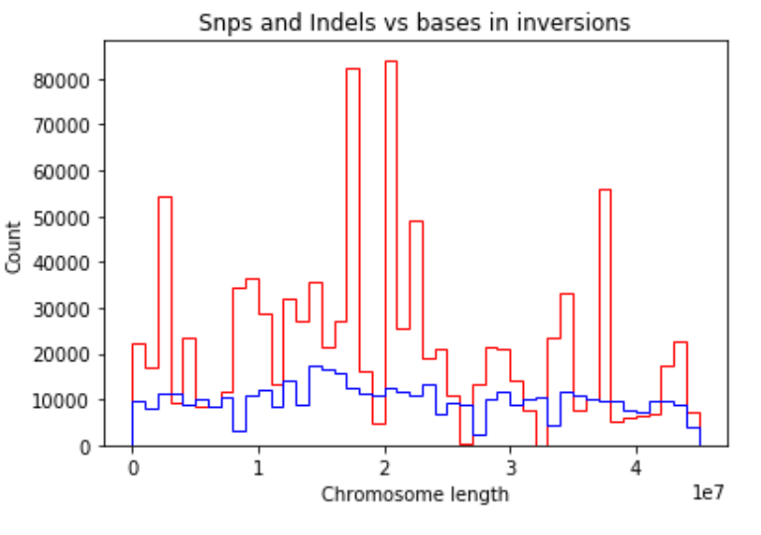

Slide 9
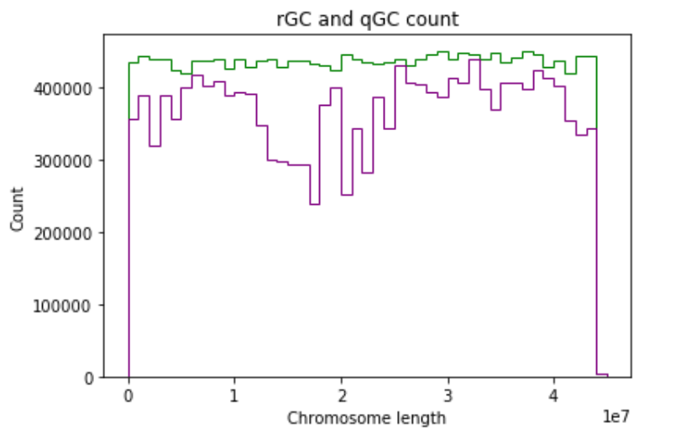

Slide 10
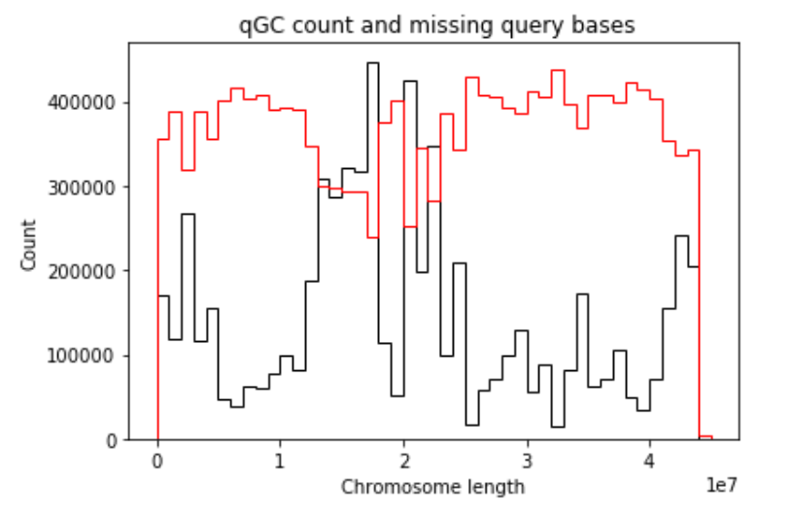

Slide 11
PCA

Slide 12
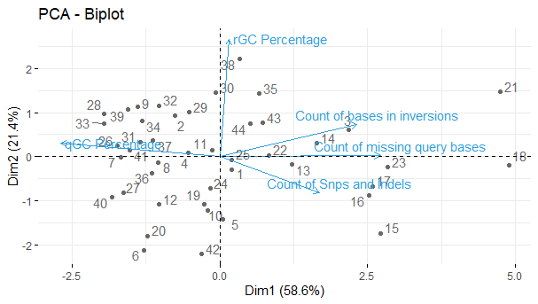

Slide 13
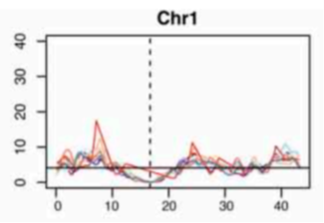
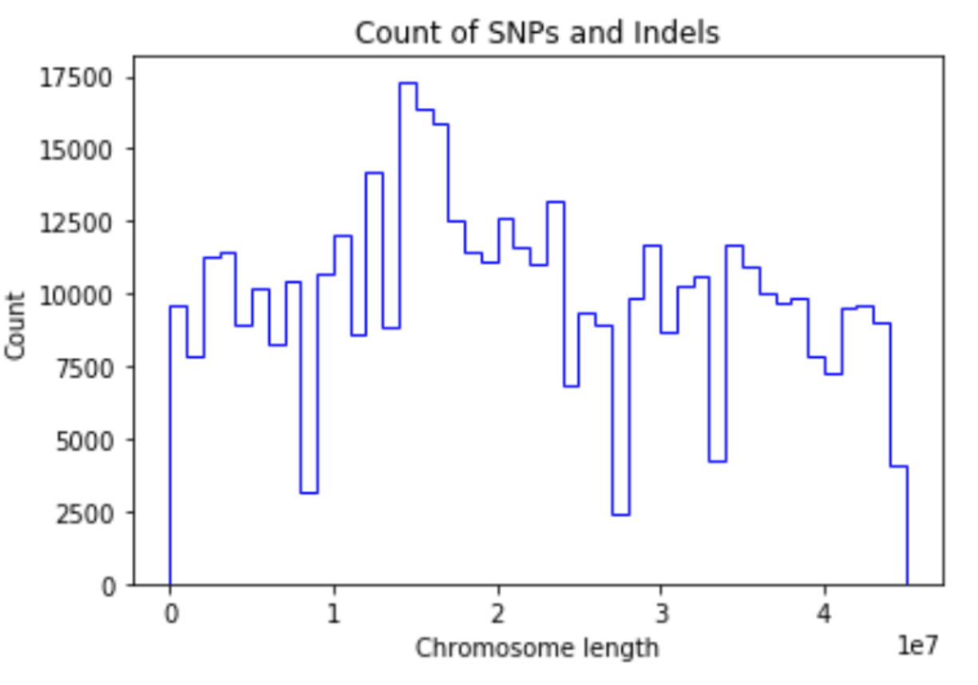
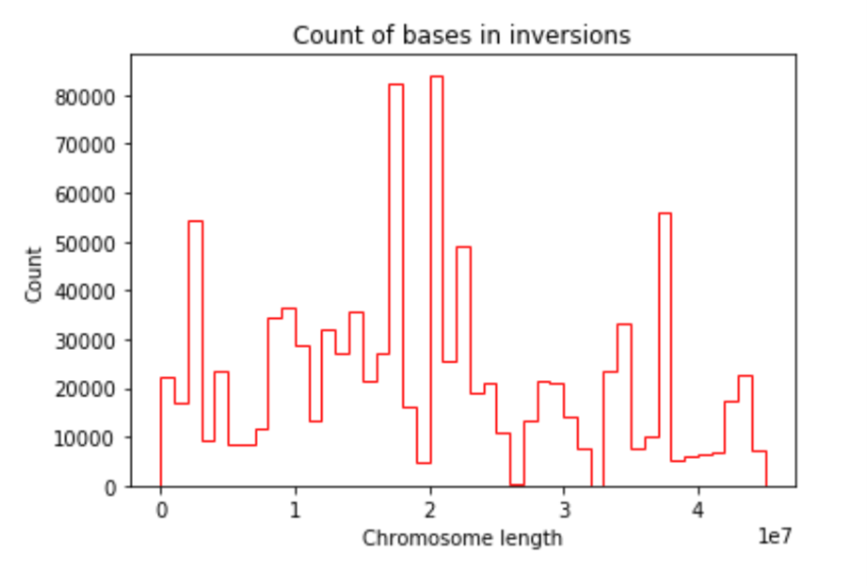
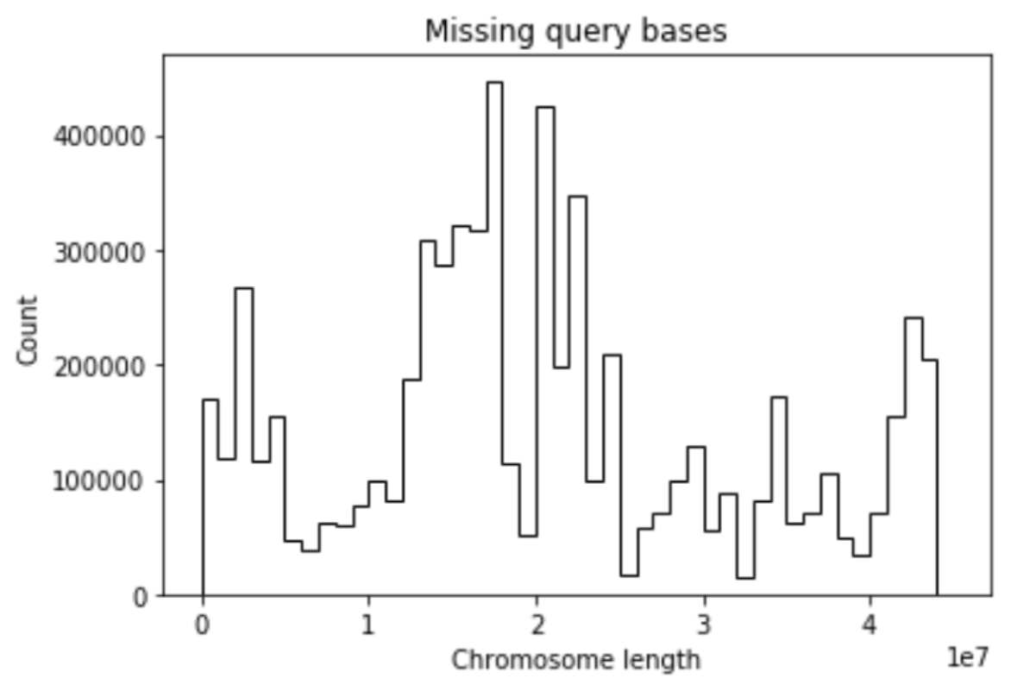


Slide 18
Low recombination group of windows

Slide 19
Low recombination group of windows

Slide 20
Low recombination group of windows

Slide 21
Low recombination group of windows

Slide 22
Low recombination group of windows
Window that never will recombine

Slide 23
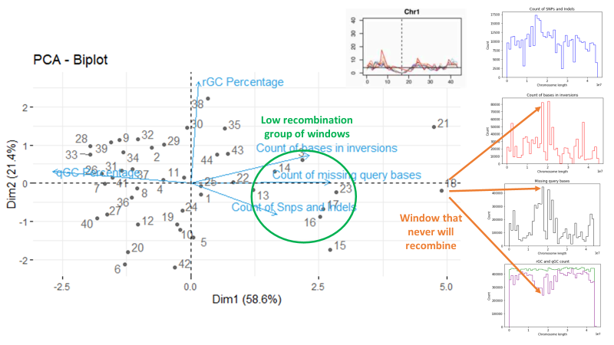
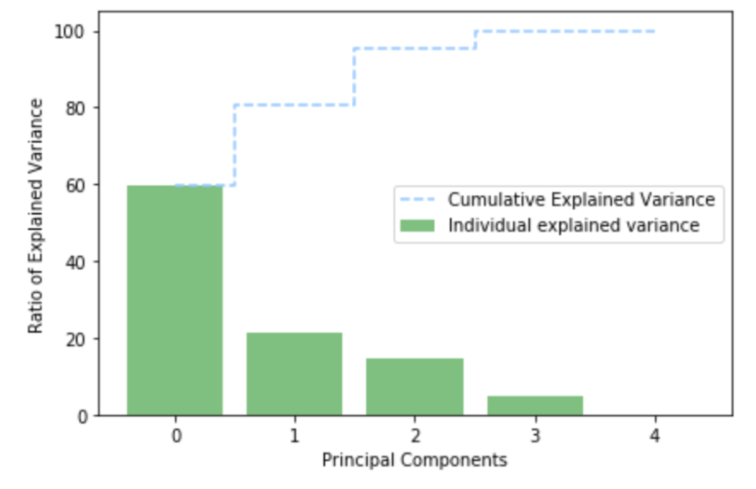
proposal
Construct a model based on the principal components using the extreme window coordinates as starts points
The idea is use all dimensions coordinates to absorb all the variability in the data
High recombination rate (100%)
Low recombination rate (0%)

